Slide 1
Researching the Obscure
How to get started with garb no one else is doing
Axera Coscolano
West Kingdom Collegium, AS 54

Slide 2
Background & caveats
I am not a historian! I am a textile conservation student
Case study: 15th and 16th C Spanish
How I got started
Notes:
First of all, I am not a historian! However, I was a science academic for a while and have a lot of experience with that. I also worked at the Lacis Museum of Lace and Textiles in Berkeley for a while where I had a lot of practice doing textile research. If you want a guide on doing academic-level history research and writing, talk to Master William of Effingeham. If you want a guide on how I started my garb research into a fairly uncommon time period or region and what I found to be helpful, you are in the correct place.

Slide 3
Pros & Cons of Obscure Garb
Pros
Cons
Avoid “reenactorisms”
Be a pioneer
Learn a lot! Spread it!
If you mess up there are fewer judges
You have to do your own research
People will not “get” your garb
Looks like you did something else, but you did it wrong.

Slide 4
Overview
Find resources
  Look for extant pieces
  Look for artists
  Look for period writings
  Look for modern books/compendiums
Establish a timeline
Look for trends
What’s missing
Learn the history

Slide 5
Find Resources: Extant pieces
Start with the big boys: The Met, V&A, LACMA, KCI
Collections are searchable but often not intuitive!
Move to museums in your area of interest.
  Feel free to contact them and ask.
Some pieces are not available
  Private collections, small museums without websites, etc.
  It is easy to miss things! Take this part slowly. Don’t frustrate yourself
Important enough to be saved== quite wealthy (usually)

Slide 6
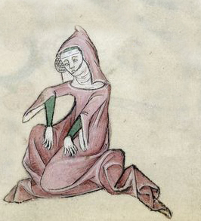
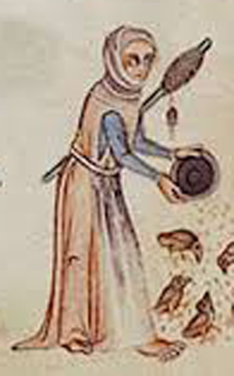

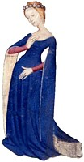
Extant Pieces vs Artistic Representation
Primary vs Secondary source
  Did the painter take artistic license?
  Did they show everything (usually no)
  Did they understand how fabric moves (ex: RUFFS)
We are used to looking at photographs
  Art is stylized→ apply it to a real body
  Ex: 14th C manuscript ladies

Slide 7
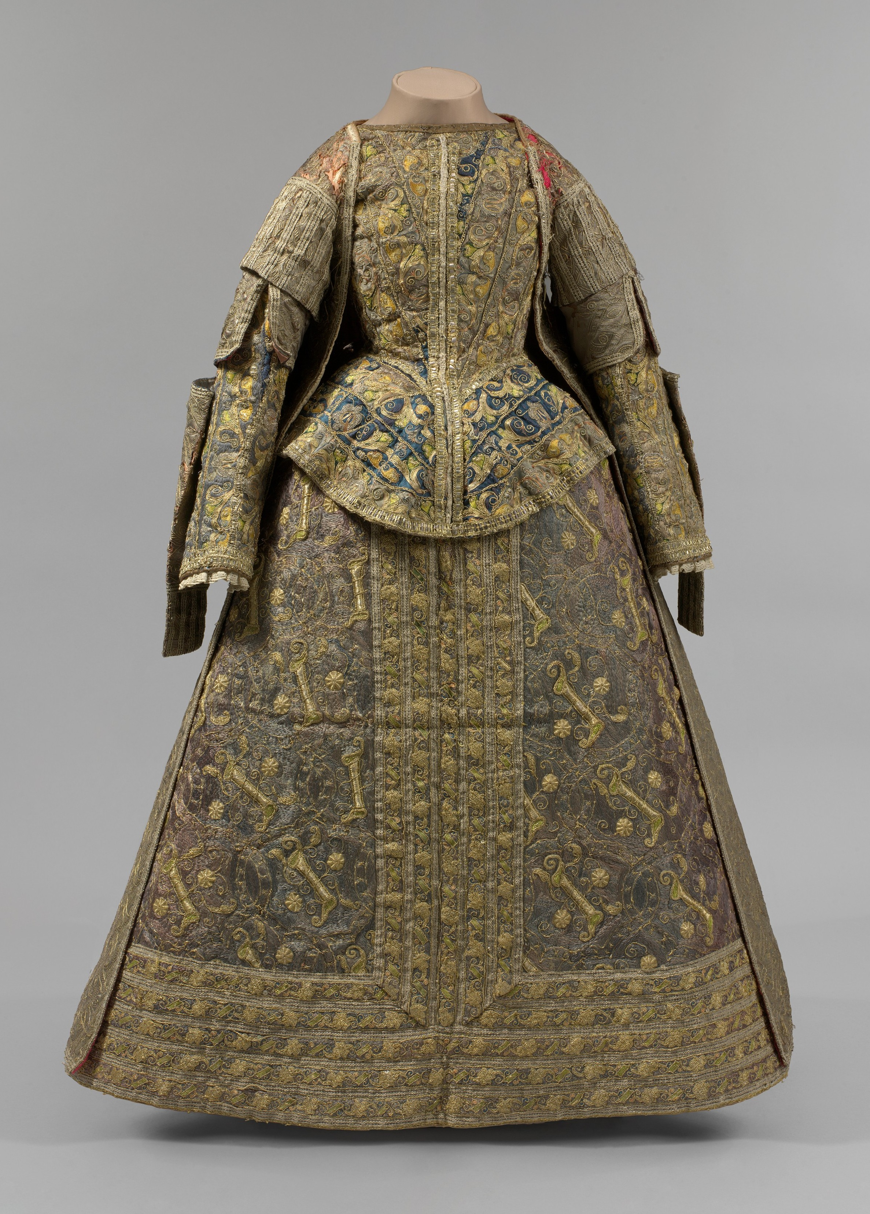
Case study: Extant Pieces
There are no late 15th C and early 16th C Spanish pieces
There are several late 16th C Spanish pieces
  Men’s suit at LACMA
  Dress ensemble at the Met
  Dress of Isabella Clara Eugenia in Toledo
  Farthingale in the Museo Ethnografico de Castilla y Leon
There are several pieces in the Spanish style, but not from Spain
Early 16th C Spanish and Italian are similar

Slide 8
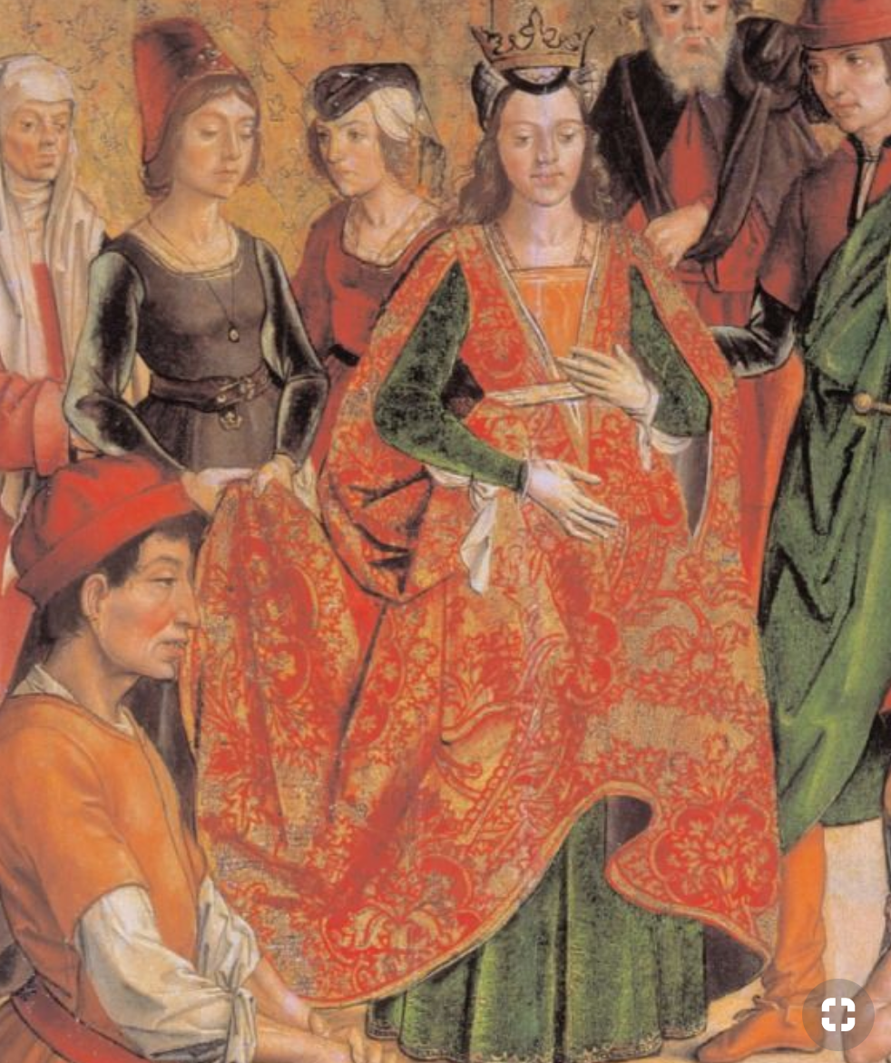
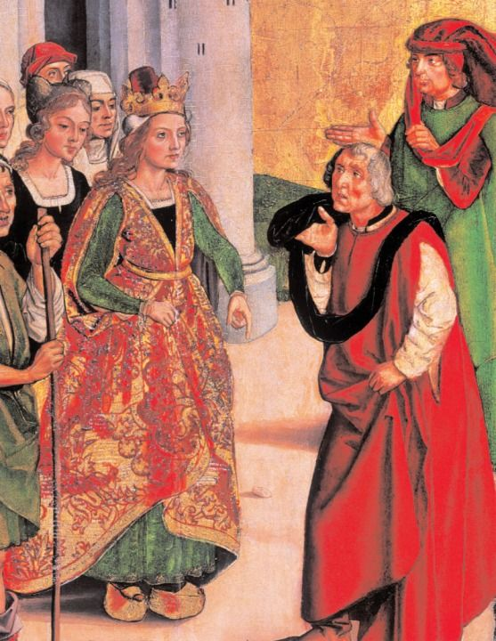
Find resources: Period Art!
Often easiest
Multiple artists
Beware of reusing clothes
Notes:
BERRUGUETE

Slide 9
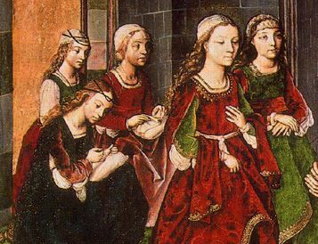
Period Art Pitfalls
Beware of title/attribution
  Pinterest is the biggest offender
  Try to trace things back to the museum/collection
Only one class or style
  “Genre painting” comes and goes
Allegorical/fancy dress
Notes:
BERRUGUETE

Slide 10
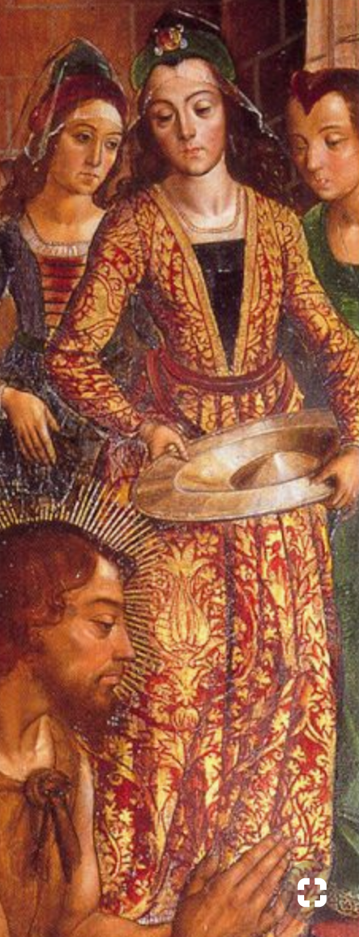
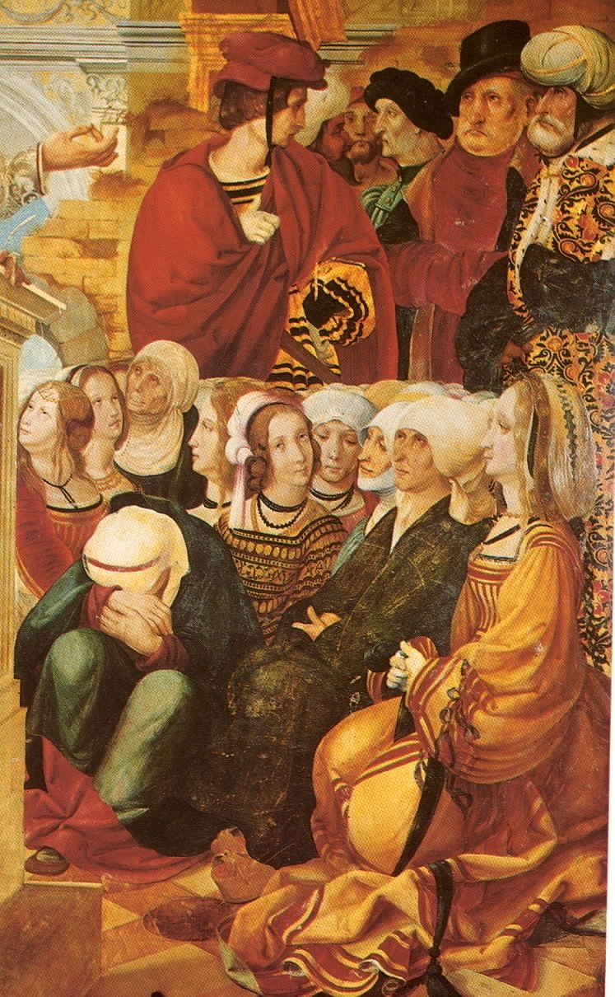
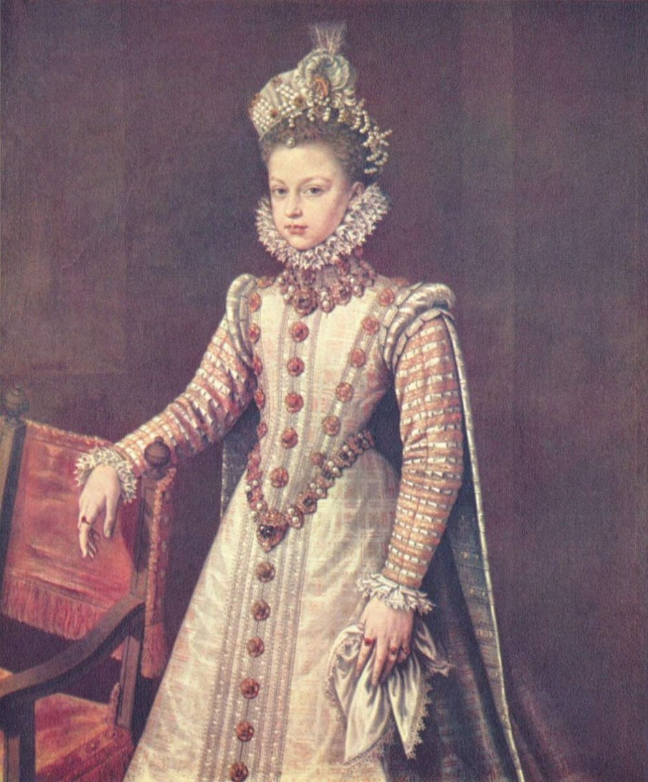
Case Study: Painters
Late 15th C
  Pedro Berruguete, Pedro Garcia de Benabarre
Early 16th C
  Das Trachtenbuch, Juan de Burgunya, Juan de Flandres
Late 16th C
  Alonso Sanchez Coello
Notes:
BERRRUGUETE

Slide 11
Find Resources: Period Writing
My least favorite resource!
Many are available online
  Antique Pattern Library
  cs.arizona.edu
Some are not– that is what good modern books are for
Translation can be challenging

Slide 12
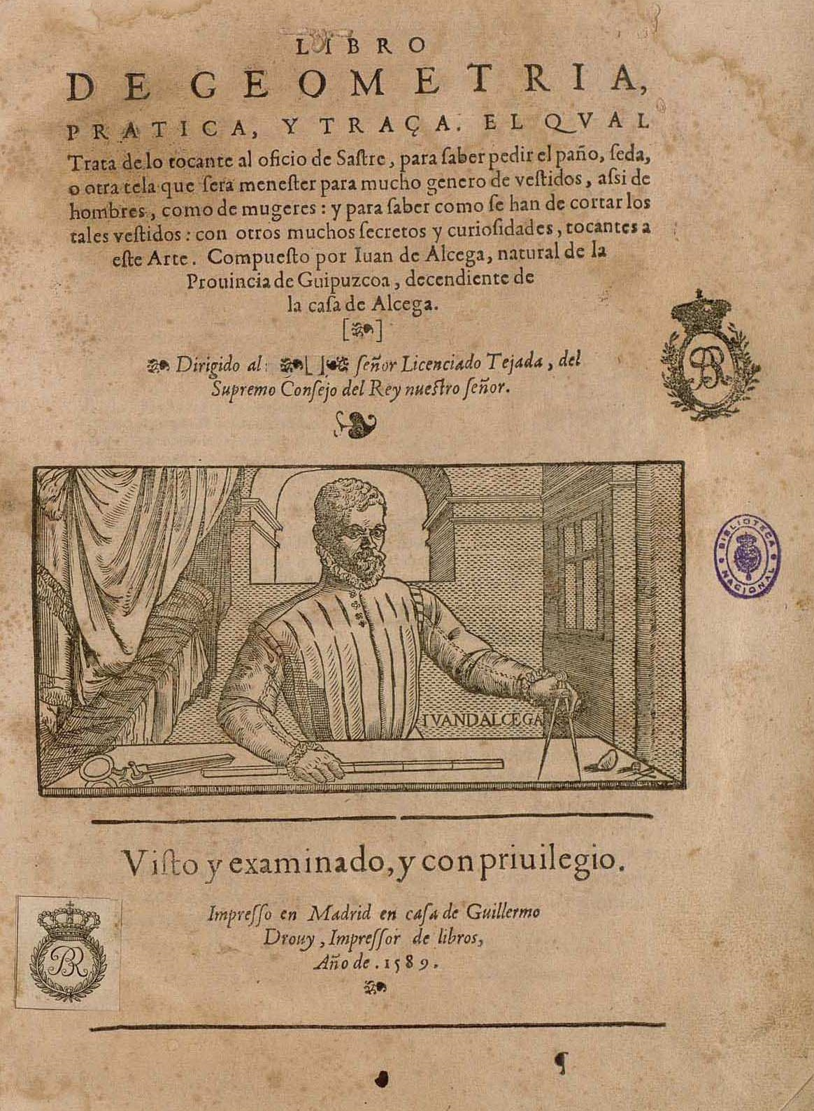
Case Study: Alcega
Tailor’s Cutting Manual 1589
Not patterns
  Small pieces are missing!
Many modern interpretations and translations→ farthingale

Slide 13
Find Resources: Books
“Sewing books”
  Ie Tudor Tailor, Medieval Tailor’s Assistant, Norse Garments Reconstructed
  Tell you how to make things
“Resource books”
  Queen Elizabeth’s Wardrobe Unlock’d, Hispanic Costume
  Tell you what to make
  Ideally mostly compiled period sources
Do not be afraid to look for academic articles!

Slide 14
Case Study: Books
Hispanic Costume by Ruth Anderson
  Two parts
  1. Period accounts of clothing
  2. Examples of certain styles in art
Spanish Costume at the Courts of Early Modern Europe
  Scholarly essays about Spanish costume and influence
  Context!
La moda a la Catalunya del segle XIV
  What happens if the information is in another language?

Slide 15
You have resources– now what?
Establish a timeline
General→ specific
  For pre 17th C aim for decades as most specific
Fashion transitions smoothly!
  Ie, 19th C petticoats→ hoop→ bustle
Fashion also (mostly) trickles down
  Wealth== most extreme version
  Try and extrapolate common fashion from court paintings

Slide 16
Look for trends
What do you see a lot?
What do you see sometimes?
What do you never see together?
Try and construct an archetypical garment
Draw it. How is it trimmed? How would you construct it? Which accessories does it have?

Slide 17
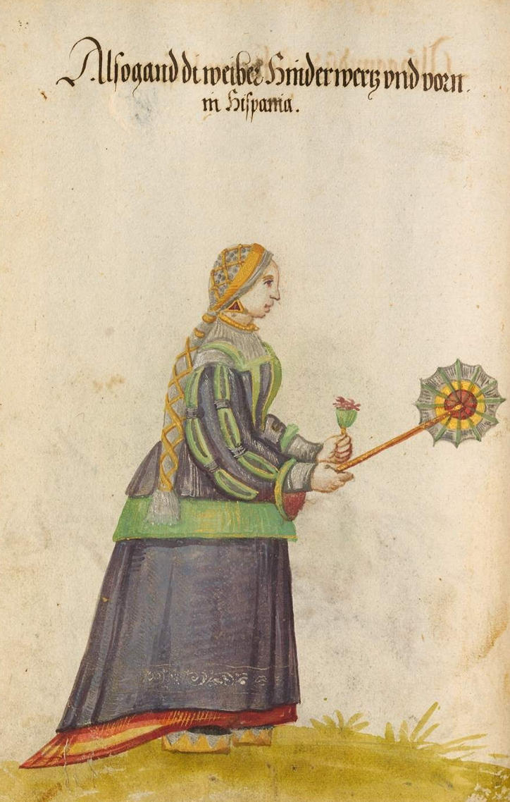
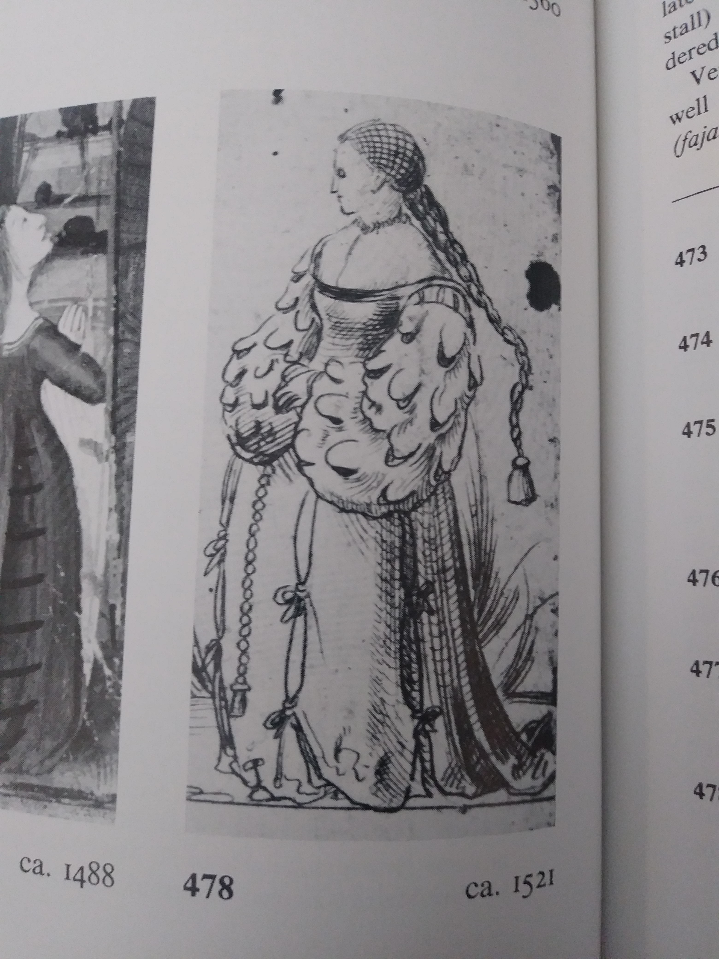
Case Study: Spanish 1520s
See a lot: Full sleeves, vertical trim on bodice, wide square neck, cofia y tranzado
See sometimes: cuttes on sleeves, split sleeves
See never: Farthingales, surprisingly!

Slide 18
Don’t forget
What’s missing?
Case study: transitional style between 1520s and 1580s

Slide 19
Remember
You will never know everything
It is more important to justify your decisions logically

Slide 20
Any questions?
Feel free to look over the books!

